Slide 1

Slide 1
Feature Based Segmentation for Transport Mode Detection using Spatial trajectory Data in Urban Environment
Mentor –
Mainik Bandyopadhyay
Presented By –
Arvind Singh Rawat
Akash Chhetri
Ayush Bhargava
Shashwat Sinha

Slide 2
Objective
This Project aims for three objectives and hence can be decomposed in three basic parts:
Project for Mode of Transport Detection :
This Project aims for the analysis of GPS data (commonly collected by the user with the help of their smartphones and a logger app) to determine the Mode of Transportation.
This project uses Segmentation algorithms to segment the GPS data to make homogenous segments and thus each segment assures that the mode of transportation in that segment is common.
The segments thus generated can be analyzed over a variety of factors to determine the Mode of Transportation. The factors involved could be Speed, Time, Location etc.
Module for Segmentation of data :
This project serves as the module for end user to use the algorithms implemented by this algorithm to preprocess their data.
This module provides different classes for different algorithms and each class contains some common attributes like data, anchors etc. while some classes may contain algorithm specific attributes.
Each method would contain a docstring that explains the use of method, its arguments and what that method returns.
Research on Segmentation Algorithms :
The project implements multiple segmentation algorithms, thus all the algorithm will work upon same data and hence provides the opportunity to measure their performances when pitted against each other in same environment.
Also, we are going to discuss the complexities of the different algorithm.

Slide 3
Algorithm Used
Dual Sliding Window
Two fixed sized windows is created adjacent to each other. The distribution of data of the both windows are then compared, if the difference exceeds the limit specified by user, then the anchor is placed between the windows.
Sliding Window
The anchor is placed when the difference created by including one more data point is more than the pre defined threshold.
Top-Down
Anchor is placed when difference between variance of subsequent segments is more than user defined threshold. The segments are computed in the Divide and Conquer manner.
Bottom-Up
Anchor is removed when the difference between means of consecutive segments is less than the user specified threshold.

Slide 4
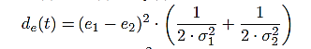
Mahalonobis Distance
where,
d_{e}(t) -> Mahalonobis Distance between two distribution
e₁ -> Mean of first distribution
e₂ -> Mean of second distribution
σ₁² -> Variance of first distribution
σ₂² -> Variance deviation of second distribution
NaN: -
When both samples are identical in nature thus we simply slide the window without saving anchor.
Inf: -
When both samples are not identical and one sample has an identical set of data that means variance is zero so, that will result in infinity.

Slide 5
Literature Survey
This project is motivated from Time Series segmentation of Urban Geo Spatial Trajectory data.
This project referenced from the following Research Papers and Journals :
Algorithmic Segmentation for Segmentation of Time Series[ 1 ]. In this paper, a comprehensive review of most common segmentation algorithms is given with the comparative analysis of them.
Automatic P-Phase Picking Based on Local-Maxima Distribution[ 2 ]. In this paper, authors propose a method for the automatic identification of P -phase arrival based on the distribution of local maxima (LM) in earthquake seismograms. We referenced the concept of Dual Sliding Window with the Mahalanobis Distance from this paper.
Automated Urban Travel Interpretation: A Bottom-up Approach for Trajectory Segmentation[ 3 ]. The research Investigates how an atomic state-based approach can be developed in such a way that can work in real time, near-real time and offline mode and in different environmental conditions with their varying quality of sensor traces. The results show the proposed bottom-up model outperforms the existing event-based segmentation models in terms of adaptively, flexibility, accuracy and richness in information delivery pertinent to automated travel behavior interpretation.

Slide 6






Methodology
Data Gathering
Data Segmentation
This step involves the extraction of data from the Source. Then, storing the data collected into a pre-defined format.
This step involves Segmentation of data on the basis of similarity. This process will decompose whole dataset into homogenous segments.
Data Cleaning
Data Analysis
This step involves removing unwanted, redundant or error prone data from the dataset. This process consists of handling NULL, NAN and any other odd values, Type casting( if needed ) and Data normalization ( If comparision is needed to be done in two features ).
This step involves multiple sub – tasks:
Identification of optimal threshold for segmentation.
Identification factor( or factors ) of classification of Mode of transportation.
Comparision of different segmentation algorithms on different factors like time complexity, space complexity, relevance etc.

Slide 7
Use cases and Application
Our project can be used in transportation science where the focus is on measuring daily travel patterns of individuals or group of individuals.
The motivation for transport mode detection is the growing need in a different kind of MaaS (Mobility as a Service) based services that require reliable information about the recognized transportation mode in order to serve their own customers with the right product offering.
Less and less human intervention will be needed since the “Intelligent System” can learn and decide upon the action to be taken with each varying data input for the prime result.
Insurance companies and ride-sharing service providers are interested in the driving behaviour of their customers and drivers.
In near future, this project can be implemented to deal with one major challenge in current GPS based approaches which is the high battery consumption.

Slide 8
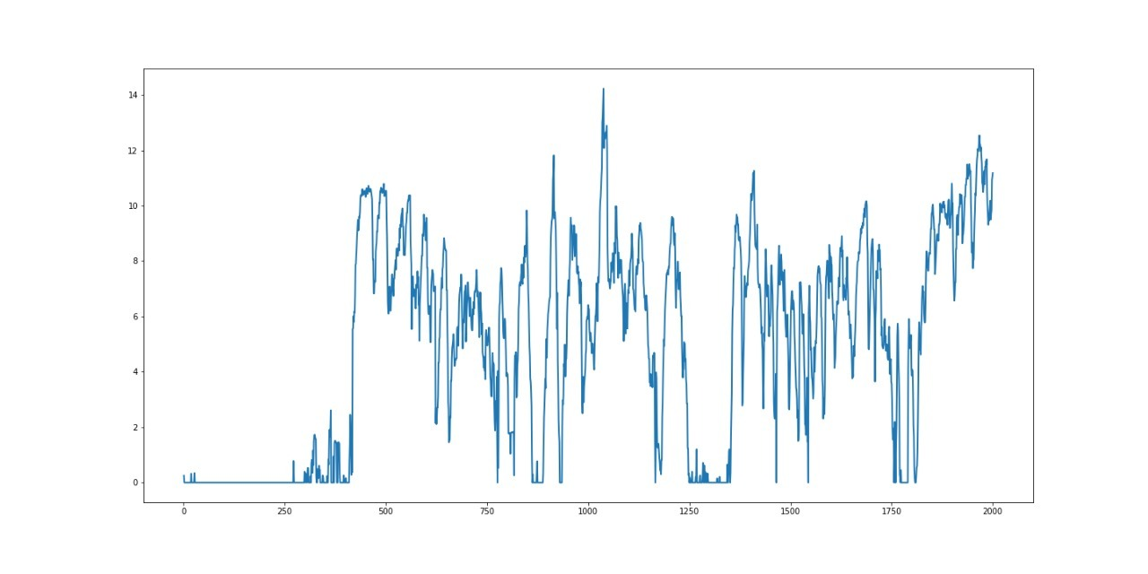
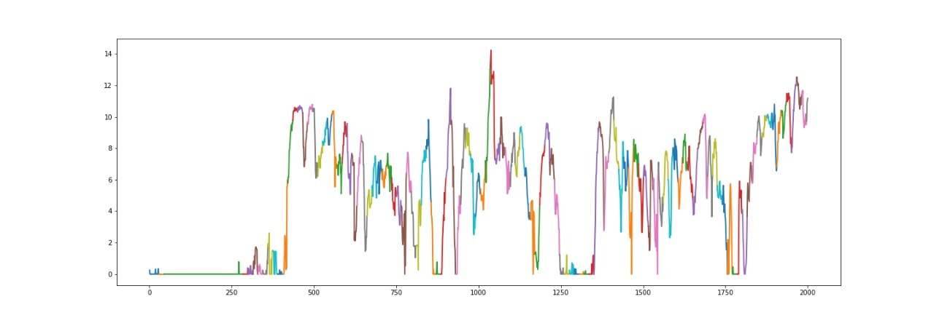
Dual Sliding Segmentation on the basis of Speed
Threshold = 0.01

Slide 9
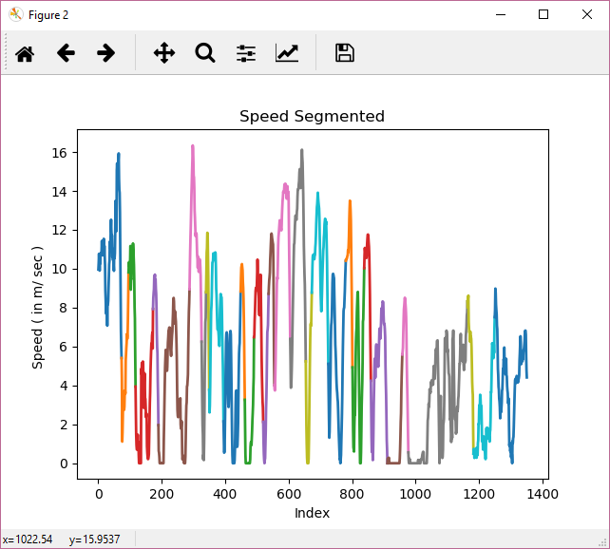
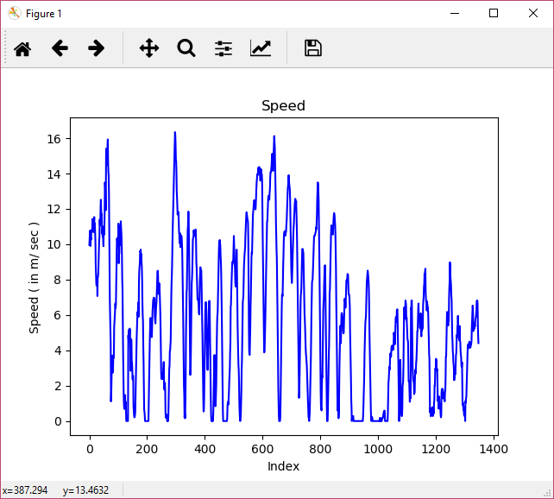
Sliding Segmentation on the basis of Speed
Threshold = 5

Slide 10
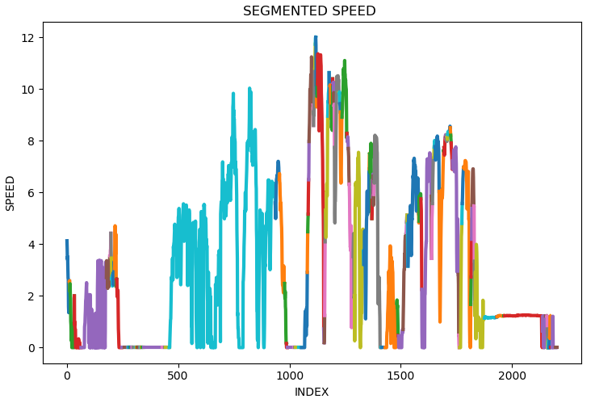
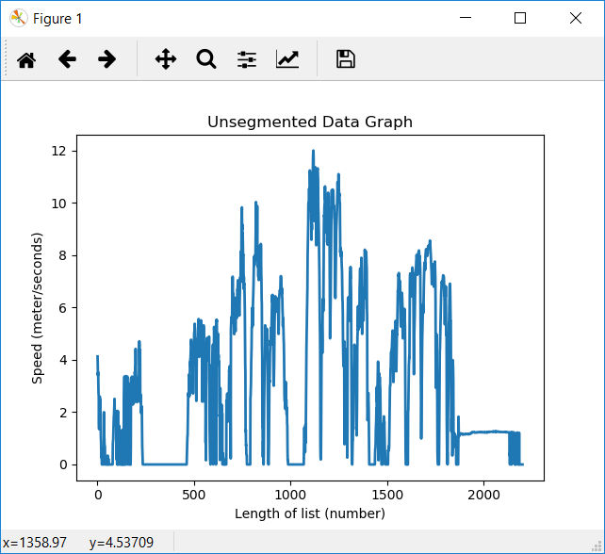
Bottom Up Segmentation on the basis of Speed
Threshold = 0.5

Slide 11
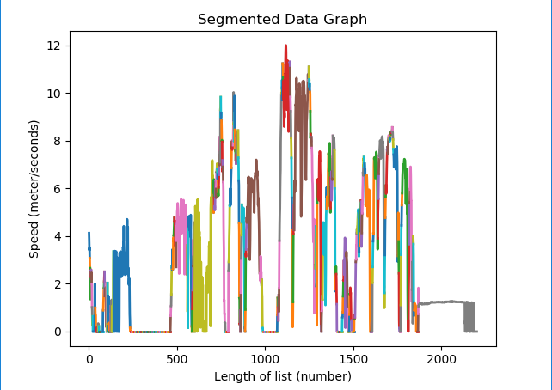
Top Down Segmentation on the basis of Speed
Threshold = 4

Slide 12




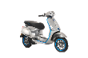
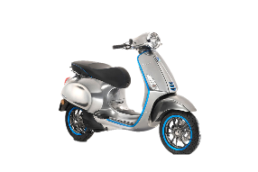

Slide 7
35%
35%
25%
43%
The adjacent graph shows the distribution of speed for the particular modes of transportation with comparison to Composite data set of multiple modes of transportation.
* After removing 0 m/sec speed

Slide 13
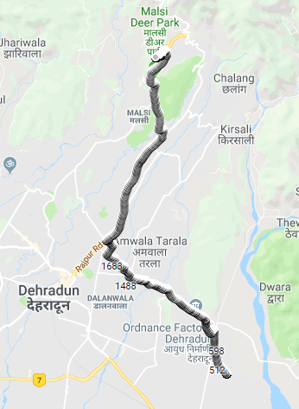

Sample dataset of DIT to a Random Place

Slide 14
References
Algorithmic Segmentation for Segmentation of Time Series
Authors : Miodrag Lovrić, PhD Marina Milanović, MSc Milan Stamenković
UDC 004.65.021:519.246.8
2. Automatic P-Phase Picking Based on Local-Maxima Distribution
Authors : Costas Panagiotakis Eleni Kokinou Filippos Vallianatos
IEEE Transactions On Geoscience And Remote Sensing, Vol. 46, No. 8, August 2008
3. Automated Urban Travel Interpretation: A Bottom-up Approach for Trajectory Segmentation
Authors : Rahul Deb Das Stephan Winter
DOI : 10.3390/s16111962

Slide 15

Slide 11
THANK YOU

